Slide 1



BUNKUP : A CONTENT-BASED FILTERING MOBILE
Application for Roommate Finding in UPLB
Fritzgerald M. Urbano and Concepcion L. Khan
CMSC 190-2
University of the Philippines - Los Baños
Notes:
Good day everyone, I am Fritzgerald M. Urbano and I will be presenting my CMSC 190 Special problem titled

Slide 2



BACKGROUND
Notes:
Let's start with the background of the study
The reopening of face-to-face classes in the University of the Philippines - Los Baños has led to a surge in students seeking accommodation, bringing new challenges, particularly in dealing with roommates.
Roommates commonly face conflicts, often related to cleanliness and communication, which can impact the quality of roommate relationships.
Recognizing the limitations of existing platforms, the study aims to address the need for a dedicated mobile application specifically designed for roommate finding at the University of the Philippines - Los Baños

Slide 3
BACKGROUND
Need for a dedicated mobile application specifically designed for roommate finding at the University of the Philippines Los Baños
Notes:
Let's start with the background of the study
The reopening of face-to-face classes in the University of the Philippines - Los Baños has led to a surge in students seeking accommodation, bringing new challenges, particularly in dealing with roommates.
Roommates commonly face conflicts, often related to cleanliness and communication, which can impact the quality of roommate relationships.
Recognizing the limitations of existing platforms, the study aims to address the need for a dedicated mobile application specifically designed for roommate finding at the University of the Philippines - Los Baños

Slide 4
OBJECTIVES
General objective of the study aims to develop a mobile application for roommate finding by utilizing content-based filtering and existing roommate pairing application features. The study also aims to provide an effective way in finding an ideal roommate for an individual based on their preferences.
Notes:
basically aims to develop a mobile app for roommate finding by using content-based filtering and existing roommate pairing application features. It also aims to provide an effective way in finding an ideal roommate for an individual based on their preferences

Slide 5
OBJECTIVES
develop a mobile application using Flutter and Firebase for roommate-finding;
apply content-based filtering and features on the roommate-finding mobile application that are used by existing matchmaking applications for matching two individuals
connect individuals with similar lifestyle preference regarding shared-housing using the roommate-finding mobile application;
Notes:
These are the objectives of the study

Slide 6
OBJECTIVES
conduct the testing of the roommate-finding mobile application on students of University of the Philippines - Los Baños;
utilize the System Usability Scale to assess the usability of the roommate-finding mobile application

Slide 7





METHODOLOGY
Tools and Technologies:
Android
Studio
Flutter
Firebase
Cloud
Firestore
WhatsApp
Notes:
For the methodology, these are the tools and technologies that were used
Android Studio - is an IDE that served as the environment for developing the application
Flutter - An open source development kit that was used
to create the user interface of the mobile application
Firebase - A Backend-as-a-Service platform that was used
for the mobile application’s backend
Cloud Firestore - A No-SQL, cloud-based database that
served as the database for the mobile application.
WhatsApp - A free cross-platform messaging service that
was used in messaging for the application.

Slide 8

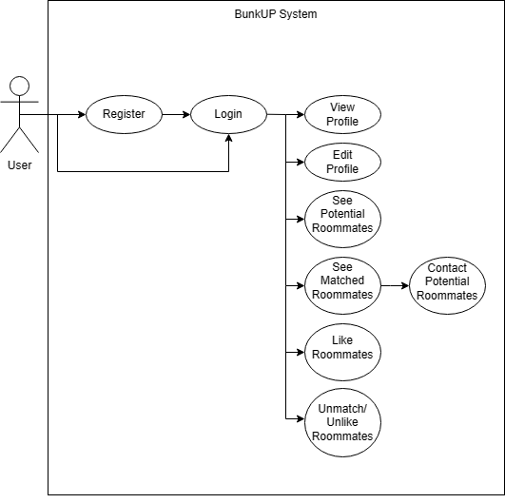

METHODOLOGY
Use-case Diagram
Notes:
This is the usecase diagram for the mobile app. The mobile app only has one type of user. The user upon opening the app can log in or register and upon logging in the user can access all the intended features of the mobile app

Slide 9
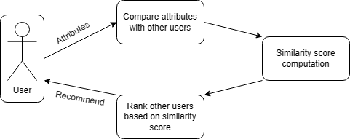
METHODOLOGY
Content-based Filtering
Notes:
As for the algorithm that was used for providing suggested roommates, content-based filtering was used. The diagram below explains how content-based filtering was applied in the application. The information provided by the users during the registration is compared to other users' attributes. If they share a similar attribute,
they will earn a point. Potential roommates will be ranked
based on the point they accumulate, with those having the most
similarities at the top of the list

Slide 10
START OF DEMO
Notes:
Let's now go the demonstration of the mobile application

Slide 11
RESULTS AND DISCUSSION
System Usability Testing
The mobile application was tested by 11 students from UPLB using the System Usability Scale and a feedback questionnaire.
The questionnaire was made using Google Forms and were shared to respondents via Facebook Messenger.
Notes:
Let us now move on to the results and discussion

Slide 12
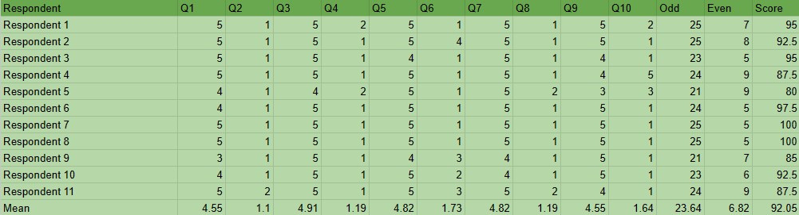
RESULTS AND DISCUSSION
System Usability Testing
The mobile application acquired a score of 92.05 out of 100 and can be classified as above average

Slide 13
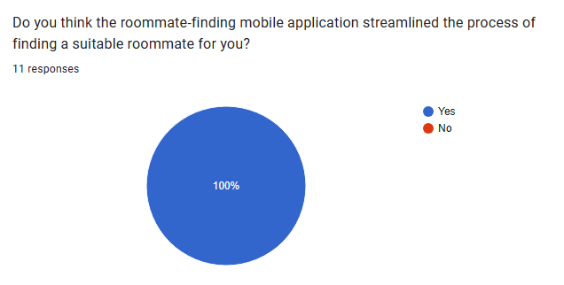
RESULTS AND DISCUSSION
Analysis of Feedback
Notes:
The respondents agreed that the proposed application was able to streamline the process of finding a suitable roommate in University of the Philippines - Los Banos

Slide 14
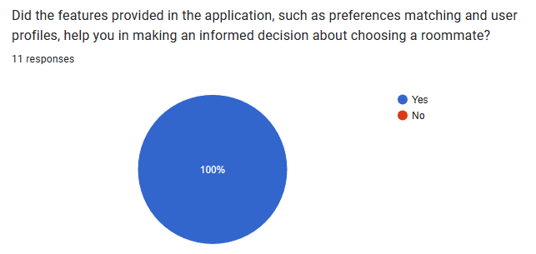
RESULTS AND DISCUSSION
Analysis of Feedback
Notes:
Incorporating preference matching proved to be useful in connecting individuals with similar preference regarding shared-housing

Slide 15
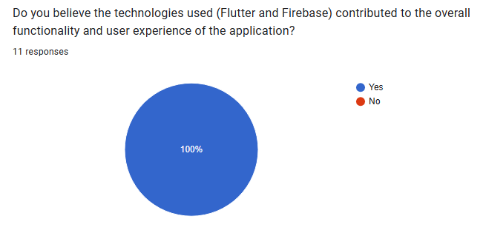
RESULTS AND DISCUSSION
Analysis of Feedback
Notes:
Use of Flutter and Firebase proved to be successful in providing better functionality and user experience

Slide 16
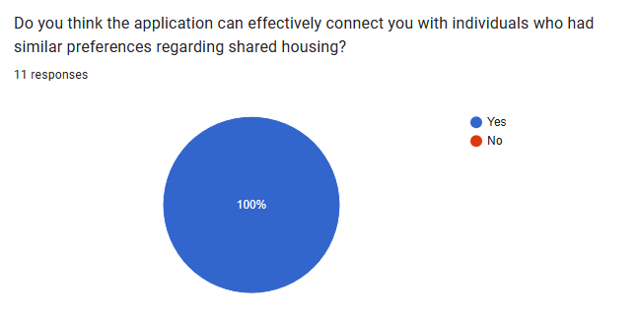
RESULTS AND DISCUSSION
Analysis of Feedback
Notes:
The application can effectively connect individuals who had similar preferences regarding shared-housing.

Slide 17
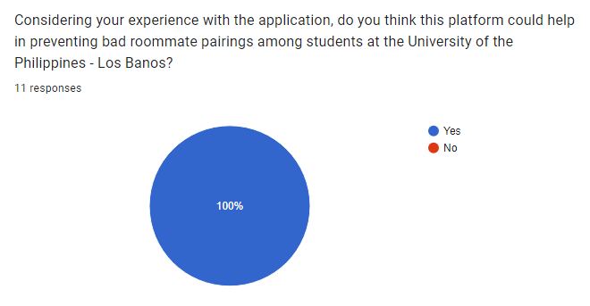
RESULTS AND DISCUSSION
Analysis of Feedback
Notes:
The application can prevent bad roommate pairings among students at the University of the Philippines - Los Baños

Slide 18
CONCLUSION
Notes:
Let's now go the demonstration of the mobile application

Slide 19
CONCLUSION
BunkUP is a mobile application designed to streamline the process of roommate-finding in UPLB. It was created using Flutter for the user interface and Firebase for the back-end services.
Notes:
Use of Flutter and Firebase proved to be successful in providing better functionality and user experience

Slide 20
CONCLUSION
The mobile application leverages functionalities of existing matching applications and incorporates content-based filtering based on the users’ provided information to deliver personalized roommate suggestions.
Notes:
Incorporating preference matching proved to be useful in connecting individuals with similar preference regarding shared-housing

Slide 21
CONCLUSION
Users can create accounts, providing personal information and lifestyle preferences, enabling them to browse ranked suggested roommate profiles, like and view other users, check mutual interest, and communicate with matches via WhatsApp integration, with account management for profile editing.
Notes:
Incorporating preference matching proved to be useful in connecting individuals with similar preference regarding shared-housing

Slide 22
CONCLUSION
Based on the feedback questionnaire:
It was also proved that the application can effectively connect individuals who had similar preferences regarding shared-housing and prevent bad roommate pairings among students at the University of the Philippines - Los Baños
Notes:
For the conclusion

Slide 23
CONCLUSION
The mobile application had an SUS score of 92.05 out of 100 and can be classified as above average.

Slide 24
FUTURE WORK
The scope of the application could be expanded aside from limiting it to students of UPLB.
An admin panel could also be implemented to be able to manage the users within the application itself and without relying on the application overview or dashboard provided by Firebase.
A better authentication process should be implemented since a lot of information from the users will be used by the application.
Notes:
For the future work

Slide 25
FUTURE WORK
Improve scalability by upgrading from the Spark plan to the Blaze plan in utilizing Firebase and Cloud Firestore.
Provide a list of suggested living spaces to streamline not only the roommate-finding process but also the housing selection process.
The design can be improved for a more engaging experience. Better error-handling and a smoother routing process could also be implemented.
Notes:
For the future work

Slide 26
IMAGES USED
https://en.wikipedia.org/wiki/University_of_the_Philippines_Los_Ba%C3%B1os
https://www.eileenwynnephd.com/blog/college-roommate-relationships-101-6-rules-to-rock-your-freshman-year-together
https://www.opensourceforu.com/2018/08/an-introduction-to-open-source-platforms-for-developing-mobile-applications/
https://iconduck.com/icons/60851/android-studio
https://iconduck.com/icons/94312/flutter
https://www.iconfinder.com/icons/1175544/firebase_google_icon
https://iconduck.com/icons/101938/file-type-firestore
https://commons.wikimedia.org/wiki/File:WhatsApp_icon.png
Notes:
These are the references for the images used in this presentation

Slide 27
BUNKUP : A CONTENT-BASED FILTERING MOBILE
Application for Roommate Finding in UPLB
Fritzgerald M. Urbano and Concepcion L. Khan
CMSC 190-2
University of the Philippines - Los Baños
Notes:
Again I am Fritzgerald M. Urbano and this is my CMSC 190 Special problem titled ____________________. Thank you for listening and I am now open for questions.

